Slide 1
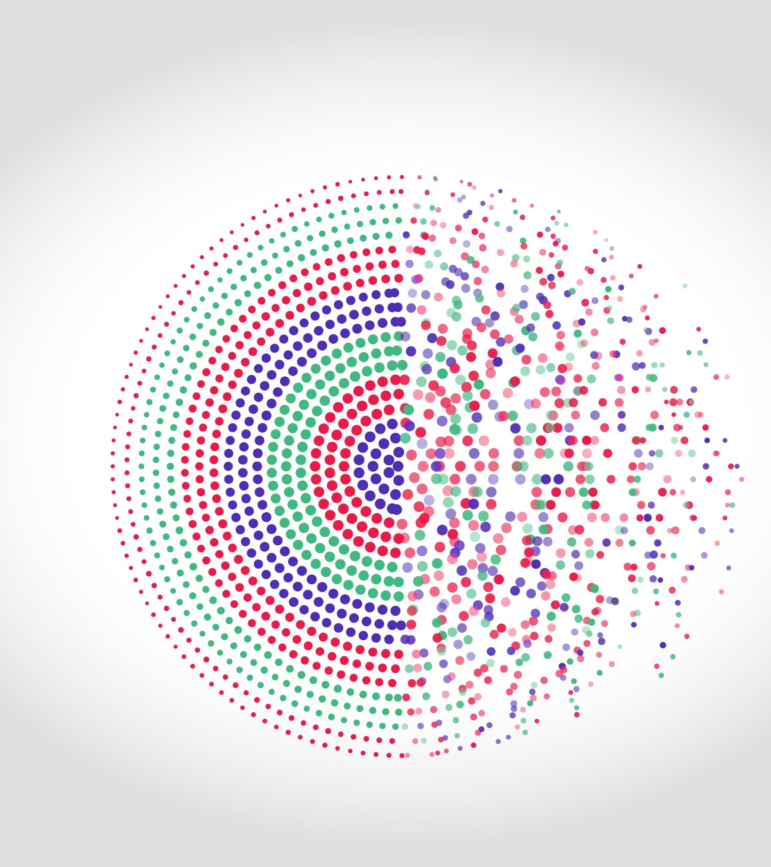
deep learning techniques for Medical image segmentation
Swathi Suragowni Ravindranath
MSBA | Advanced Machine Learning Project

Slide 2
What problem are you addressing?
Lung cancer is the deadliest of all cancers afflicting both sexes, accounting for 18.4% of the total cancer deaths worldwide in 2018, almost equal to breast and colon cancers combined.
Automated detection and segmentation would immediately impact the clinical workflow in radiotherapy, one of the most common treatment modalities for lung cancer. Radiotherapy uses medical imaging, especially computed tomography (CT), to obtain accurate tumor localization and electron densities for the purpose of treatment planning dose calculations.
Accurate segmentation of the tumor and organs at risk are also essential as errors might lead to over- or under-irradiation of both the tumor and/or healthy tissue.
It has been estimated that a 1 mm shift of the tumor segmentation could affect the radiotherapeutic dose calculations by up to 15%.
Therefore, automated accurate segmentation can significantly reduce the time needed by clinicians to carryout treatment planning, and adaptive re-planning of treatment depending on the changes in the tumor.

Slide 3
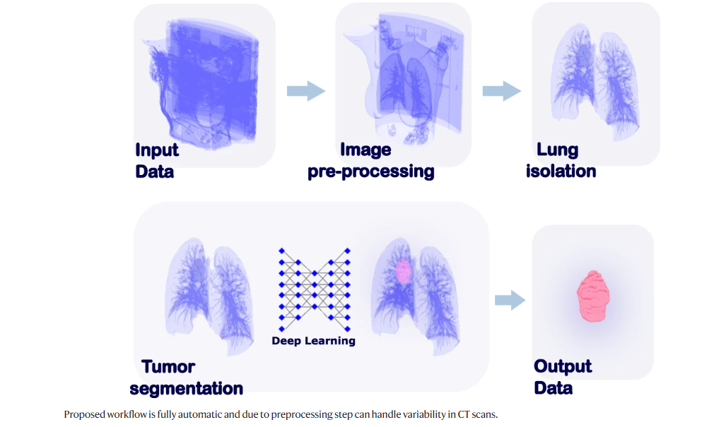
What technique(s) did you use?
I have implied the below techniques for slice-wise tumor segmentation.
The Process projected in the below image was followed to get the desired results.

Slide 4
Description of Data
The pretreatment CT scans of Lung cancer patients were retrospectively collected and anonymized by each center.
CTs of lung abnormalities other than NSCLC were included in the training dataset as negative examples, allowing our method to exclude them from the detection and segmentation process
lung CT slices without contours were also used in the training process as negative samples, thereby increasing the number of unique training samples and decreasing the false-positive rate of the model.
Image preprocessing
A harmonization routine for the preprocessing of CT scans in order to more comprehensively unify patterns on the images for the models to learn from.

Slide 5
Lung region isolation:
First, the CT couch is detected and removed from the image volume. Air-filled connected volumes are detected and region growing, and morphological operations are applied in order to remove small vessels and to connect adjacent regions, resulting in a 3D binary lung mask.
The spine axis is identified, and the lung mask is halved and symmetrically flipped about the sagittal plane, keeping the union of the flipped and the original lung masks.
By doing so, the algorithm is optimized for handling lung abnormalities such as atelectasis, pulmonary infiltration, consolidation, and fibrosis.
Tumor detection and segmentation:
The widely used 2D U-net convolutional neural network (CNN) was employed for slice-wise tumor segmentation.
The axial projection was used to train the network due to the higher resolution of image representation in this plane.

Slide 6
Data Augmentation:
In order to increase the robustness of the system to a wide range of imaging parameters, the training dataset was expanded using augmentation techniques with the following parameters.

Slide 7
Conclusion :
Detection and segmentation of abnormalities on medical images is highly important for patient management including diagnosis, radiotherapy, response evaluation, as well as for quantitative image research. In this Project I have presented a fully automated pipeline for the detection and slice wise segmentation of lung cancer developed and validated on multiple thoracic CT scans. Along with quantitative performance detailed by image slice thickness, tumor size, image interpretation difficulty, and tumor location. I have demonstrated that on average, radiologists & radiation oncologists preferred automatic segmentations in 56% of the cases.

Slide 8
Contributions to the class:
Though the techniques used were already studied in class. We have learnt about Image segmentation using pixels. In this method we have learnt that in an image with various entities, we want to know which pixel belongs to which entity, for example in an outdoor image, we can segment the sky, ground, trees, people, etc.
My contribution to the class was to use new method i.e., Slice wise tumor segmentation.
Slicer wise tumor segmentation is the automated detection and segmentation method that mainly helps doctors to identify the tumor without any manual intervention.
As per my knowledge we learnt about convolution network methods, and I have used this new technique for Medical Image segmentation.
This method is applied as follows:
I have used Ct scan as input.
This complex CT scan image was divided into slices as shown in above results.
I have Reshaped input data to feed into the network with shape (depth*#image, width, height, channel)
Convolution 2d, U-net and many other methodologies were used to determine the efficiency.

Slide 9
Thank You

